Slide 1


Slide 2

Domain: Finance

Slide 3

DEVELOPING A WEBSITE FOR FINANCIAL AWARENESS

Slide 4

FEATURES OF THIS WEBSITE

Slide 5

A section prompting the user to learn about the problems faced due to lack of financial literacy

Slide 6
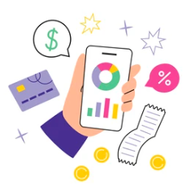
A section having personalized budget tracker for the user

Slide 7
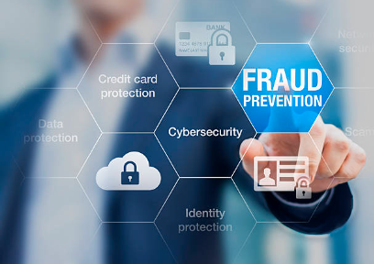
A section for user to learn about different types of fraud

Slide 8
FIRST SECTION

Slide 9

When the user clicks the button for first section, he will
be able to learn about the problems faced due to lack of
financial literacy
(recall of phase 1)

Slide 10
SECOND SECTION

Slide 11
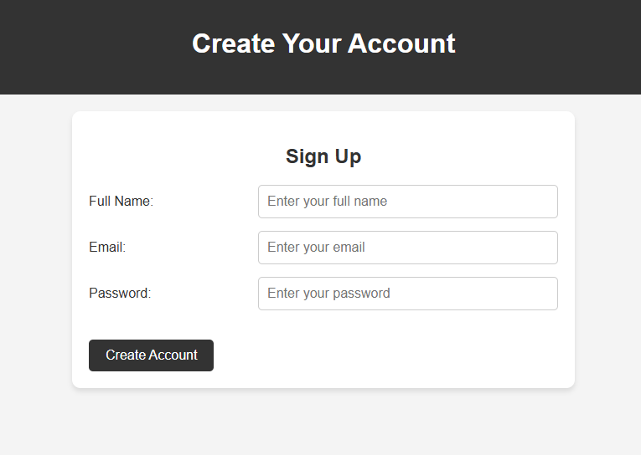
When the user clicks the button for second section, he will
be prompted to make his account.

Slide 12
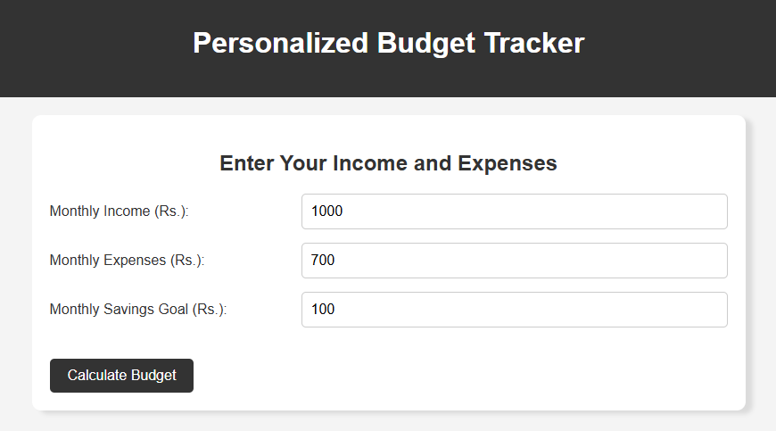
When the user clicks “Create Account”, he will be directed to another webpage

Slide 13
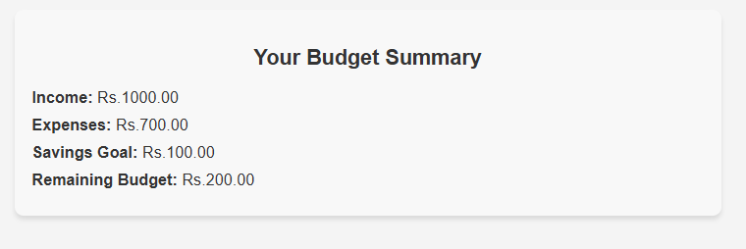
When the user clicks “Calculate Budget”, his budget will be calculated.

Slide 14
FUTURE IMPLEMENTATIONS FOR THIS SECTION

Slide 15
1. Income Section:
Monthly/Weekly Income: A place to input your primary sources of income (e.g., salary, freelance work, side gigs).
Other Income: Space for irregular income like gifts, bonuses, or passive income.
Total Income: Automatically calculates total income for the period

Slide 16
2. Expense Categories:
Fixed Expenses: Monthly recurring expenses, such as rent/mortgage, utilities, insurance, and subscriptions.
Variable Expenses: Expenses that change month-to-month, such as groceries, entertainment, and dining out.
Savings/Investments: Budgeting for future savings, retirement, and investments.
Debt Repayment: Tracking loan or credit card payments.

Slide 17
3. Budgeted vs Actual Comparison:
Budgeted Amount: Set a budget for each category (e.g., $300 for groceries).
Actual Amount: Track the actual spending for each category.
Variance: Compare budgeted vs. actual to see if you're on track. Highlight overages or savings.

Slide 18
4. Summary and Analysis
Income vs Expenses: A section that shows whether you're living within your means (income - expenses).
Savings: Track how much you're saving each month and whether you're hitting your savings goals.
Trends and Insights: Graphs or charts to visualize spending habits over time and identify areas for improvement

Slide 19
5. Security and Privacy Features
Password Protection: Ensure your tracker is password-protected or encrypted for added security.
Data Backup: Back up your data to the cloud in case of device failure.

Slide 20
THIRD SECTION

Slide 21
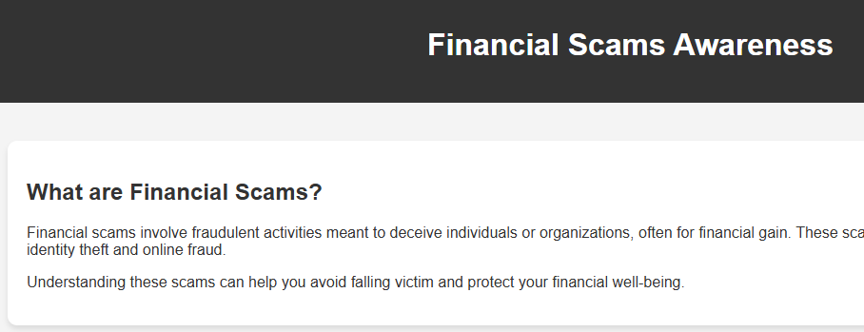
When the user clicks the button for third section, he will
be prompted to another webpage where he will learn about different types of scams.

Slide 22
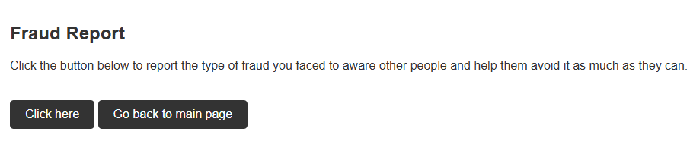
At the end of page, he will be able to report the type of fraud he faced to aware other people

Slide 23
We created a google form and asked people to fill it.
Click to get to the link

Slide 24
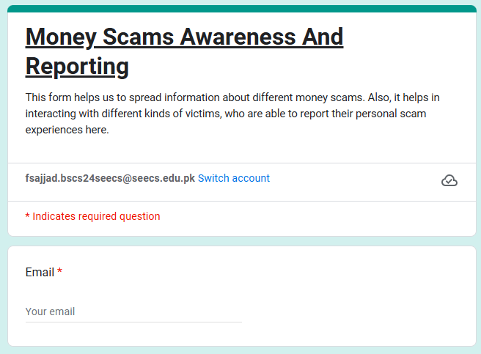

Slide 25
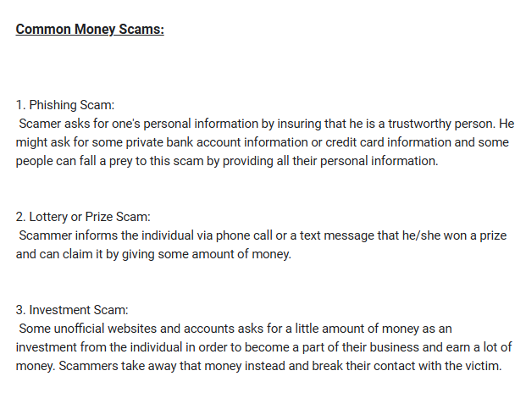

Slide 26
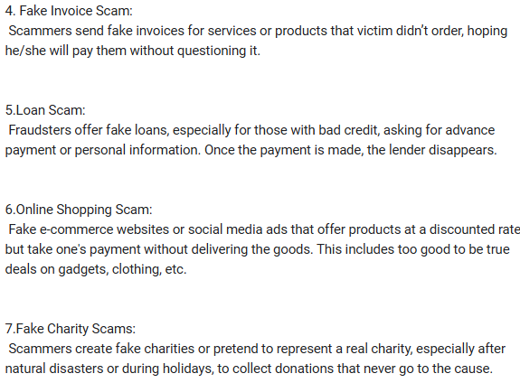
Awaring the user about different types of scams

Slide 27
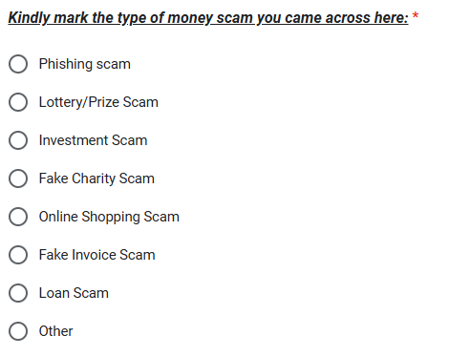
Asking user which type of scam he faced

Slide 28
The most common scam faced in Pakistan was

Slide 29
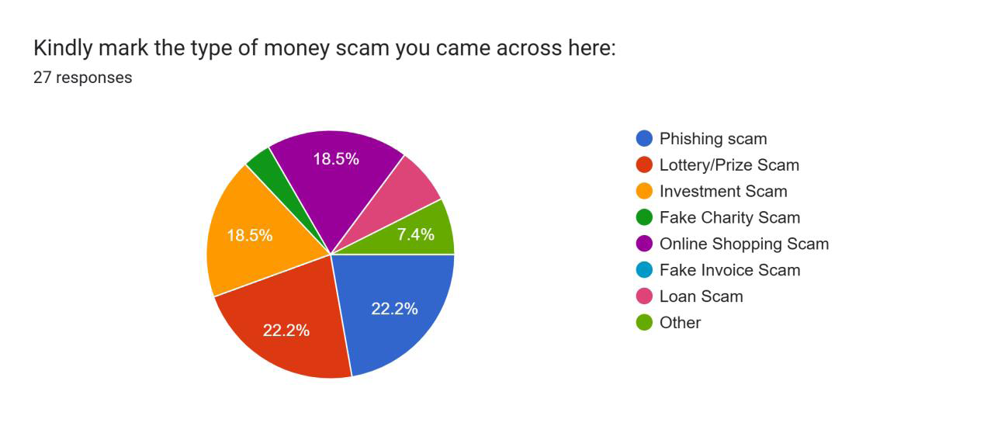
Lottery/Prize scam and Phishing scam

Slide 30
FUTURE IMPLEMENTATION FOR THIS SECTION

Slide 31
A person fills out the form → the data is sent to a server → the server saves the data in the database
Future Integration:
The form will collect reports submitted by user.
The database will store all that information securely.
Automation: Forms and databases will connect automatically.
Real-Time Updates: Information will be instantly saved and used.
Smarter Systems: We can use the data quickly for reports, emails, and more!

Slide 32
Any Questions?

